Slide 1
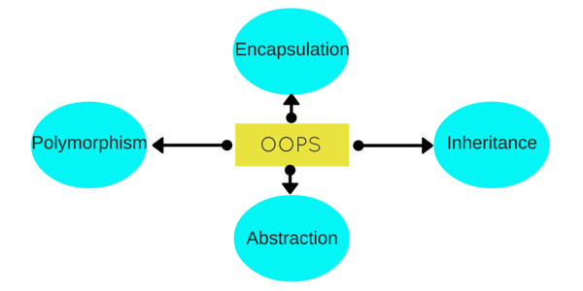
Object oriented programming in java

Slide 2
INTRODUCTION
In this page, we will learn about basics of OOPs. Object Oriented Programming is a paradigm that provides many concepts such as inheritance, data binding, polymorphism etc.

Slide 3
OOPS CONSEPTS
Object means a real word entity such as pen, chair, table etc. Object-Oriented Programming is a methodology or paradigm to design a program using classes and objects. It simplifies the software development and maintenance by providing some concepts:
Object
Class
Inheritance
Polymorphism
Abstraction
Encapsulation

Slide 4
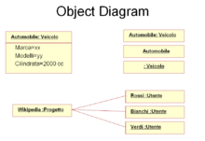
Object
Any entity that has state and behavior is known as an object. For example: chair, pen, table, keyboard, bike etc. It can be physical and logical.

Slide 5
Interesting, right?
This is just a sneak preview of the full presentation. We hope you like it! To see the rest of it, just click here to view it in full on PowerShow.com. Then, if you’d like, you can also log in to PowerShow.com to download the entire presentation for free.

